Slide 1
Design and Analysis of Algorithms
CS345
Lecture 15
Depth First Search in Directed Graph - III

Slide 2
Recap of the last lecture

Slide 3



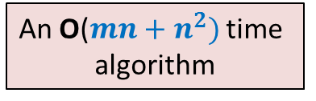
Strongly connected components
Definition: Two vertices $u$ and $v$ are said to be strongly connected if
$u$ is reachable from $v$
$v$ is reachable from $u$
A strongly connected component:
a maximal subset of “strongly connected vertices”
x
An O($m+n)$ time algorithm
An O($mn+n^{2})$ time
algorithm
y
u
v
q
b
d
w
j
r
p
h
c
t
k

Slide 4
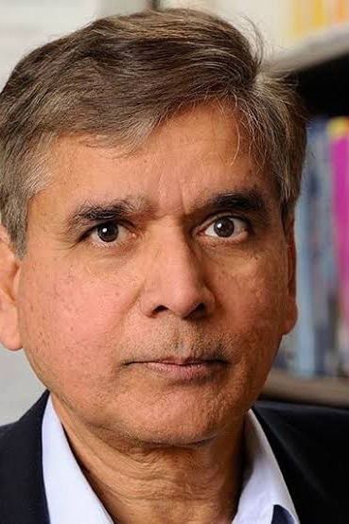
Kosaraju’s Algorithm
DFS Traversal
A simple but very powerful idea
Mtech IIT KGP
PhD Uni. Pennsylvania
Faculty at John Hopkins University

Slide 5




A simple but very powerful idea
$G$ : the given directed graph
$G^{r}$: the graph $G$ after reversing edge directions;
Let us see whether you can use it in today’s lecture ☺
SCCs of $G$
?
SCCs of $G^{r}$

Slide 6
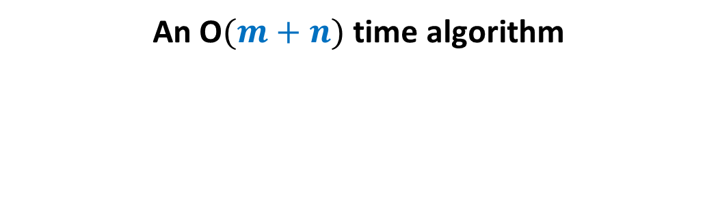
Computing SCCs efficiently
An O$(m+n)$ time algorithm

Slide 7
Observation 1
Any path in the graph
x
x
?
z
An SCC
z

Slide 8
Observation 1
All vertices on the x-z path belong to the same SCC.
Any path in the graph
x
x
z
An SCC
z

Slide 9
Inference of Observation 1
Notation (root of an SCC):
the vertex of the SCC
which is visited first during the DFS.
r
r
An SCC

Slide 10
Inference of Observation 1
Notation (root of an SCC):
the vertex of the SCC
which is visited first during the DFS.
All vertices of the SCC will be descendants of r in the DFS tree.
There may be vertices from other SCCs that will be descendant of r.
But, the entire SCC appears contiguously in the subtree rooted at r.
r
r
An SCC

Slide 11
Try to spot the roots of SCC in the DFS forest.
x
x
y
y
u
u
v
q
v
q
w
j
w
j
r
p
r
p
Let us analyse the finish time.
Since it worked for topological ordering ☺
k
t
k
t
b
b
d
d
h
h
c
What should we do ?
Having seen nice structure of SCCs in the DFS forest, we feel motivated to design an efficient algorithm based on DFS.
But how should we start with ?
If we can find out the roots of SCCs, we can find respective SCCs.
But this appears to be as difficult as computing SCCs.

Slide 12
Study Finish time
u
u
There does not appear to be any order ☹.
v
v
q
q
w
j
w
j
r
p
r
p
t
k
t
k
t w k j v r p q u
Increasing order of F[]

Slide 13
Searching for an order using Finish time
It looks too complex !
SCC A
SCC D
SCC B
Have some perseverance, buddy !
SCC C
Increasing order of F[]
Where might be
the roots of each SCC ?
Let us analyse the finish time.
Of the roots of SCCs. May be there exists some order there !

Slide 14





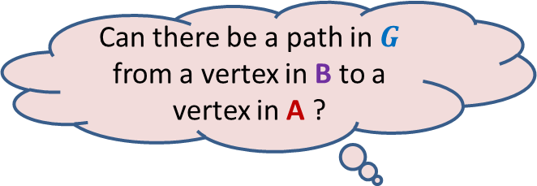
DFS on Directed Graph
Analyzing the finish time of roots of SCCs
F[root($\text{A}$)] ? F[root($\text{B}$)]
Can there be a path in $G$ from a vertex in B to a vertex in A ?
So DFS of B will finish before DFS of A begins
No. since such a path would imply that
A and B together form a single SCC.
$$u$$
$$v$$
$$\text{A}$$
$$\text{B}$$
>
Notes:
No. since such a path would imply that A and B together form a single SCC.

Slide 15


DFS on Directed Graph
Analyzing the finish time of roots of SCCs
F[root($\text{A}$)] ? F[root($\text{B}$)]
SCC $\text{B}$ is bound to be traversed during DFS( )
$$u$$
$$v$$
$$\text{A}$$
$$\text{B}$$
>

Slide 16

DFS on Directed Graph
Analyzing the finish time of roots of SCCs
Lemma 3: Let $\text{A}$& $\text{B}$ be any two SCCs. If there is an edge ($u$,$v$) with $u∈A$ & $v∈B$,
then
F[root($\text{A}$)] > F[root($\text{B}$)]
$$u$$
$$v$$
$$\text{A}$$
$$\text{B}$$

Slide 17

DFS on Directed Graph
Analyzing the finish time of roots of SCCs
Lemma 3: Let $\text{A}$& $\text{B}$ be any two SCCs. If there is an edge ($u$,$v$) with $u∈A$ & $v∈B$,
then
F[root($\text{A}$)] > F[root($\text{B}$)]
➔ If F[root($\text{A}$)] < F[root($\text{B}$)], there cannot be any edge from $\text{A}$ to $\text{B}$.

Slide 18
Searching for an order using Finish time
SCC A
NEVER
SCC B
Increasing order of F[]
Can there be an edge from some vertex of A to some vertex of B ?

Slide 19
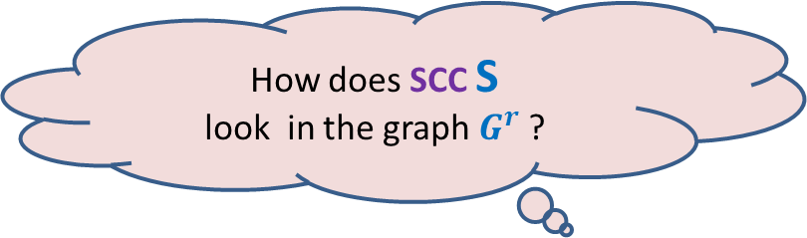




Searching for an order using Finish time
What can we infer for the vertex with max finish time ?
$$u$$
SCC S
$$u$$
SCC S
There won’t be any edge from some vertex outside S into S in $G$.
Time to use the !dea of $G^{r}$.
Get ready.
How does SCC S
look in the graph $G^{r}$ ?

Slide 20



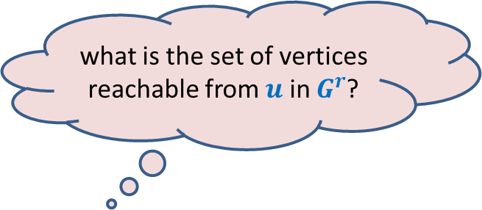

what is the set of vertices reachable from $u$ in $G^{r}$?
$$G^{r}$$
$$u$$
Answer: SCC of $u$.
Can you see an algorithm for computing SCCs now ?
It is just here … ☺
SCC S
$$u$$
SCC S
There won’t be any edge from any vertex in S to any vertex outside S in $G^{r}$.

Slide 21
Algorithm for computing SCCs
SCC A
SCC D
SCC B
SCC C
How should we compute SCCs ?

Slide 22



Algorithm for computing SCCs
Execute BFS or DFS on $x$ in $G^{r}$
Remove SCC C
So, how to proceed ?
$$x$$
SCC C
The reachability information of the rest of the graph $G^{r}$ remains unchanged.
This is because there was no outgoing edge from SCC C that we just removed.

Slide 23


Algorithm for computing SCCs
Execute BFS or DFS on $x$ in $G^{r}$
Remove SCC C
Execute BFS or DFS on $y$ in $G^{r}$
Remove SCC D
SCC D
$$y$$

Slide 24


Algorithm for computing SCCs
Execute BFS or DFS on $x$ in $G^{r}$
Remove SCC C
Execute BFS or DFS on $y$ in $G^{r}$
Remove SCC D
Execute BFS or DFS on $z$ in $G^{r}$
Remove SCC B
$$z$$
SCC B

Slide 25

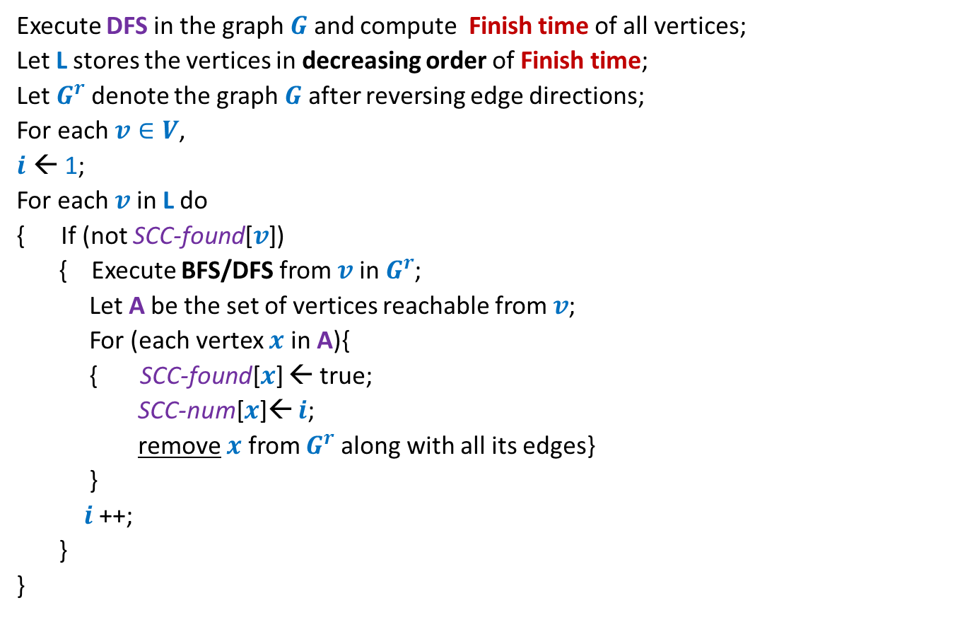
Algorithm for computing SCCs
Execute DFS in the graph $G$ and compute Finish time of all vertices;
Let L stores the vertices in decreasing order of Finish time;
Let $G^{r}$denote the graph $G$ after reversing edge directions;
For each $v∈V$,
$i$ ← 1;
For each $v$ in L do
{ If (not SCC-found[$v$])
{ Execute BFS/DFS from $v$ in $G^{r}$;
Let A be the set of vertices reachable from $v$;
For (each vertex $x$ in A){
{ SCC-found[$x$] ← true;
SCC-num[$x$]← $i$;
remove $x$ from $G^{r}$along with all its edges}
}
$i$ ++;
}
}
SCC-found[$v$]
← false ;

Slide 26
Optional Programming Assignment
Design
neat,
compact,
and efficient
implementation of the Kosaraju’s algorithm.

Slide 27


Novel ideas used
Analyzing Finish time of roots of SCCs
SCCs of $G$
SCCs of $G^{r}$
The entire algorithm looks so simple and elegant. These ideas also look simple.
But it might have taken enormous amount of time to combine them so effectively.
And, of course, enormous amount of perseverance ☺

Slide 28
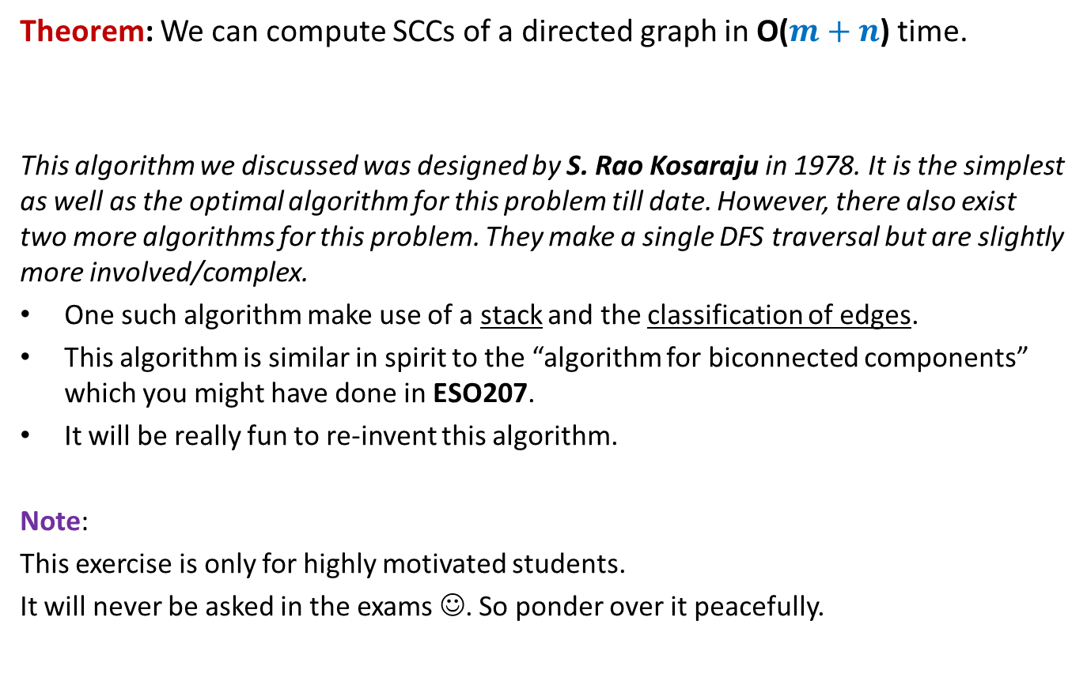
Conclusion
Theorem: We can compute SCCs of a directed graph in O($m+n$) time.
This algorithm we discussed was designed by S. Rao Kosaraju in 1978. It is the simplest as well as the optimal algorithm for this problem till date. However, there also exist two more algorithms for this problem. They make a single DFS traversal but are slightly more involved/complex.
One such algorithm make use of a stack and the classification of edges.
This algorithm is similar in spirit to the “algorithm for biconnected components” which you might have done in ESO207.
It will be really fun to re-invent this algorithm.
Note:
This exercise is only for highly motivated students.
It will never be asked in the exams ☺. So ponder over it peacefully.

Slide 29
SCC graph of $G$
This should convince you about the importance of the linear time algorithm for SCC that we discussed.

Slide 30
SCC graph of $G$

Slide 31


SCC graph
x
{x,y}
y
u
v
q
{u,v,w,j}
{p,q,r}
w
j
r
p
{t}
{k}
t
k
{b,c,d}
b
d
h
{h}
c
$$G$$
SCC graph of $G$

Slide 32
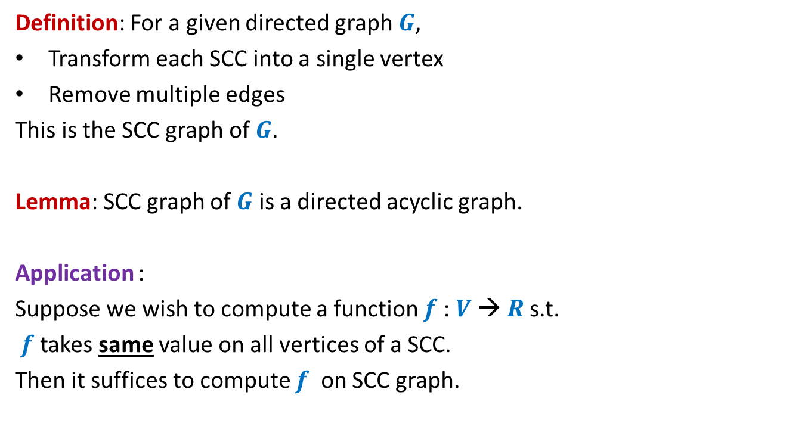
SCC graph
Definition: For a given directed graph $G$,
Transform each SCC into a single vertex
Remove multiple edges
This is the SCC graph of $G$.
Lemma: SCC graph of $G$ is a directed acyclic graph.
Application :
Suppose we wish to compute a function $f$: $V$→ $R$s.t.
$f$ takes same value on all vertices of a SCC.
Then it suffices to compute $f$ on SCC graph.

Slide 33
Other Applications of DFS
Applications:
Checking if a graph is Eulerian.
Maximum flow,
Matching,
…

Slide 34
Dynamic Programming
This paradigm is more difficult to internalize and use compared to the previous paradigms.

Slide 35
Revisiting the first problem from ESC111/112
you solved using recursion

Slide 36
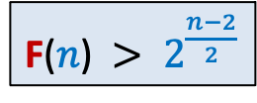
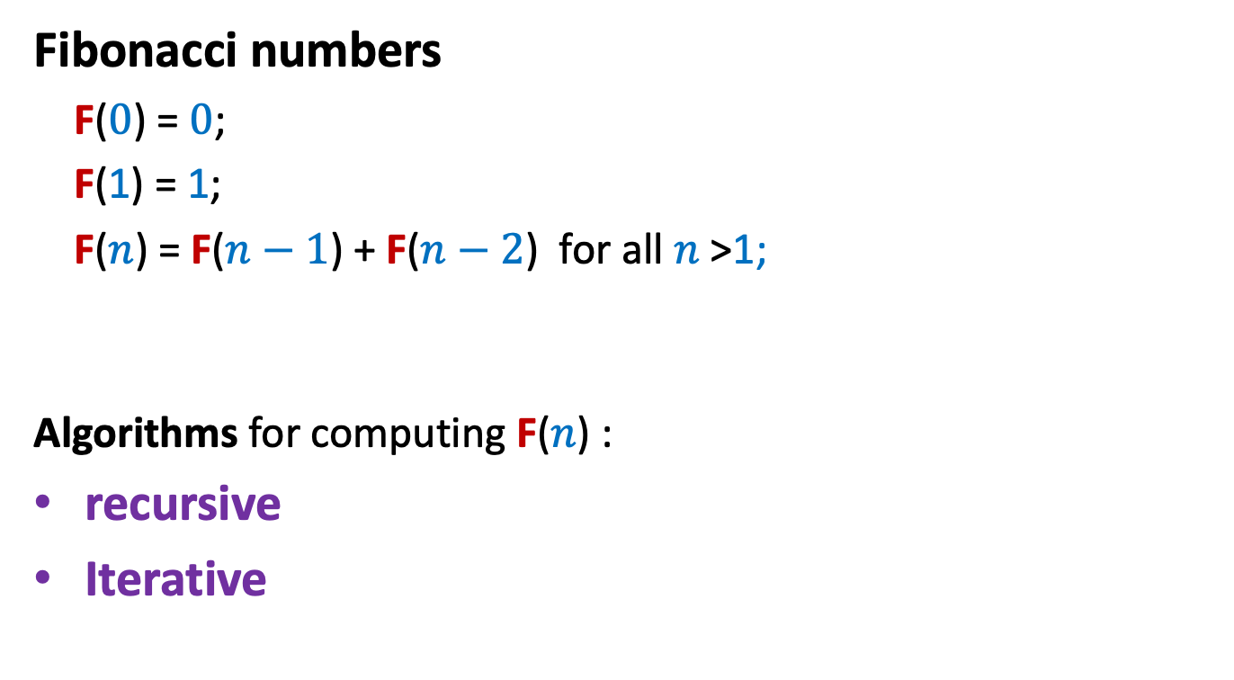
Fibonacci numbers
Fibonacci numbers
F($0$) = $0$;
F(1) = 1;
F($n$) = F($n−1$) + F($n−2$) for all $n$ >1;
Algorithms for computing F($n$) :
recursive
Iterative
F($n$) $> 2^{\frac{n−2}{2}}$

Slide 37



Recursive algorithm for F($n$)
Rfib($n$)
{
if $n=0$return $0$;
else if $n=1$return $1$;
else return( Rfib($n−1$) $+$ Rfib($n−2$) )
}
Real time to run for $n=1000$ ?
Hours, days, months …
Let us look at its recursion tree to find the exact cause of its inefficiency.

Slide 38













Recursive algorithm for F($n$)
Recursion tree
The algorithm computes
$\text{F}$($n−2$)
$\text{F}$($n−3$)
…
$\text{F}$($1$)
$\text{Rfib}$($n$)
$2$ times
$3$ times
$\text{Rfib}$($n−1$)
$\text{Rfib}$($n−2$)
$\text{F}$($n$) times
$\text{Rfib}$($n−3$)
$\text{Rfib}$($n−4$)
$\text{Rfib}$($n−2$)
$\text{Rfib}$($n−3$)
Homework:
Recall the iterative algorithm that avoids it.
$\text{Rfib}$($n−3$)
$\text{Rfib}$($n−4$)
F
Are you able to locate the cause of inefficiency of the recursive algorithm ?
0 1

